Slide 1
RMP.ai
Leveraging Large Language Models in Software Engineering to Summarize Professor Ratings
CS5130
Hamza Khairy | Antwan Fares

Slide 2
Problem
Need
Professor ratings are scattered across platforms like Rate My Professor.
Analysis of feedback is time-consuming and subjective.
Automate collection, summarization, and analysis of professor ratings.
Provide students with insights to make better decisions.
Notes:
"Selecting the right professor is an essential part of the academic experience, yet it can be a time-consuming and subjective process. Currently, students rely on platforms like Rate My Professor, but manually analyzing multiple comments is inefficient. Our solution leverages Natural Language Processing (NLP) techniques to streamline this process, categorizing feedback and summarizing key insights to help students make more informed decisions."

Slide 3
Motivation
Lack of automated tools to categorize and summarize professor feedback.
Difficulty in drawing objective conclusions from a wide range of ratings.
Create a system that systematically classifies feedback and identifies trends.
Notes:
"Despite the wealth of reviews on platforms like Rate My Professor, students often struggle to sift through the information and extract useful insights. Our project aims to fill this gap by developing a system that automatically categorizes and summarizes reviews, making it easier to evaluate professors and make informed course selections."

Slide 4
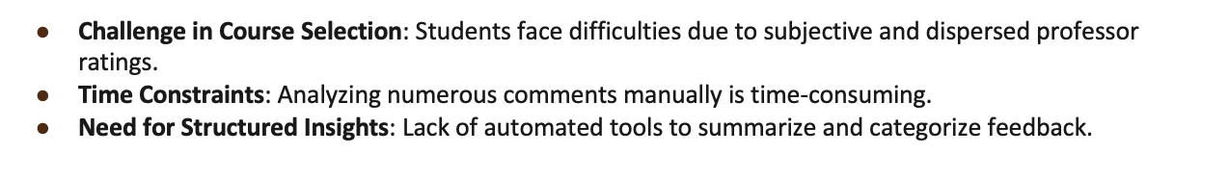
Motivation
Why RMP.ai?

Slide 5
Techniques
NLP:
Summarization: Condense reviews into key points.
Sentiment Analysis: Classify feedback as positive, neutral, or negative.

Slide 6






Software Architecture
Scraping Data
Ai Analysis
RMP.Ai API
GUI Package
Notes:
"We utilize a combination of NLP techniques to summarize and classify professor reviews. For summarization, we extract key insights from a collection of reviews. For sentiment analysis, we classify each review as positive, neutral, or negative. The implementation relies on the RateMyProfessor API and Google’s Generative AI model, both of which we use to process and generate insights from user feedback. The tool also presents the summary and sentiment results in a user-friendly interface."

Slide 7
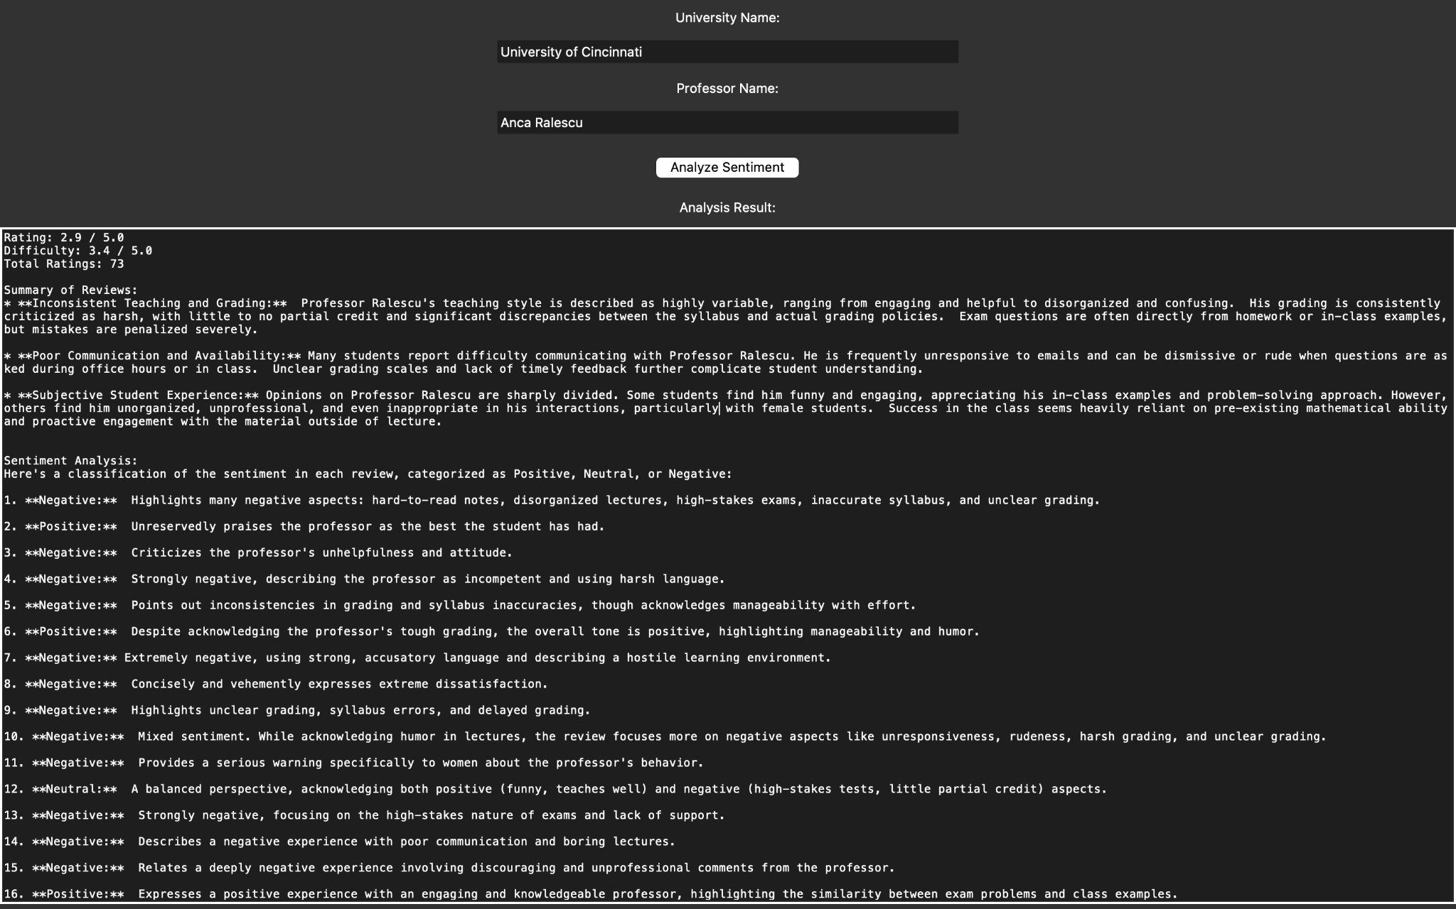
Implementation
Notes:
"Here’s a brief look at our code. The key functions are designed to collect reviews, summarize them, and perform sentiment classification. We also have a GUI component where users input the professor's name and university, and the system displays a detailed analysis of reviews, including summarized insights and sentiment analysis."

Slide 8
Evaluation
Effectiveness Metrics:
Accuracy of sentiment classification.
Relevance of summarized feedback.
User Testing:
Gather feedback from students to assess the utility of recommendations.
Comparative Analysis:
Compare automated results to manual review of comments.
Notes:
"To evaluate the effectiveness of our system, measured the accuracy of sentiment classification and the relevance of the feedback summaries. We plan to survey students to determine how useful and reliable they find our recommendations compared to manually reviewing professor ratings."

Slide 9
Conclusion
Streamlined Professor Selection: Our project leverages AI and NLP to automate the process of summarizing professor reviews, providing students with valuable insights.
Improved Decision-Making: By categorizing reviews based on key qualities, students can make more informed choices regarding professors and courses.
Collaborative Effort: Successful teamwork, with Hamza focusing on AI integration and prompt engineering, and Antwan developing the API and GUI, ensured the project’s smooth execution.
Future Enhancements: The project lays the groundwork for further improvements, such as real-time recommendations and integrating more review platforms.

Slide 10
Future Work
New Feature: Personalized Professor Matchmaking
• Wish Box Input: Students can specify desired qualities in a professor.
• AI Analysis: Uses NLP and machine learning to compare professor profiles with student wishes.
• Similarity Score: Delivers a percentage score indicating match level.
• Goal: Improve student satisfaction and decision-making in course selection.
• Implementation: Integrate with existing platform for seamless user experience.

Slide 11
Thank You!
RMP.ai Your professors, rated
Do you have any questions?

